Slide 1
Exercise with Article: Territorial Peace and Democratic Clustering Jaeseok Cho

Slide 2
Outline
Background
Literature Review
Theory
Research Design
Findings
Conclusion

Slide 3
Background
Democratic Clustering
Democracy demonstration effects
Clustering Effect

Slide 4
Background
Democracies cluster over space and time (Gleditsch 2002a; Gleditsch and War 2006)
Then, when does Democratic Transition occur?

Slide 5

Zootopian World?

Slide 6
Background
Really?
May be we are confused with other causal mechanisms?
May be better indicators?

Slide 7
Background
Then, why do some countries transit faster than other countries?

Slide 8
Argument
Level of territorial threats is the better indicator of democratic transition

Slide 9
Literature Review
States surrounded by threatening neighbors tend to be more militarized and adopt authoritarian regime
(Desch 1996; Hintze 1975; Thompson 1996; Tilly 1985)
Territorial threats are highly correlated with the occurrence of militarized conflict (Sense and Vasquez 2008; Vasquez 2009)

Slide 10
Theory
Absence of serious territorial threates means no more need for large standing armies
Less need for strong centralized authority
More spending for economic growth
More likely lead to democracy

Slide 11
Excercise
Q1: What is the hypothesis that the authors try to prove?

Slide 12
Hypotheses
“H1: Higher levels of territorial threat decreases the likelihood that a nondemocratic state will transition to democracy” (Gibler and Tir, 2014, p.30)

Slide 13
Excercise
Q2: Does the authors’ data correspond to the question they ask?

Slide 14
Research Design (First Stage)
DV: Presence of Fatal MID
IV: Shared colonial heritage
Violent teritorial transfer
Defense Pact
Civil War
Militarization Level
Previous Territorial MID

Slide 15
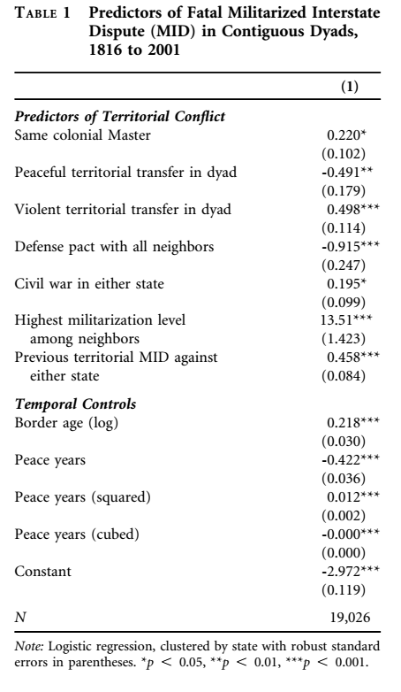

Slide 16
Research Design (Second Stage)
DV: Transition of a state to democracy (passes from 5 or below to 6 or above of polity index from Polity IV project)
IV: Threat variable from table 1 (0 to 1)
CV: Lack of land borders using Island state dummy

Slide 17
Research Design (Method)
Logistic Regression , clustered by states with robust standard errors

Slide 18
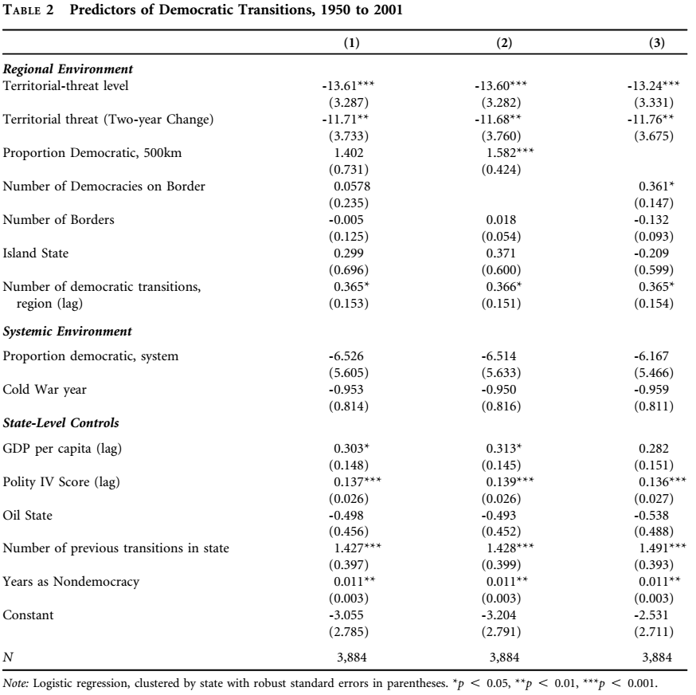

Slide 19
Excercise
Q3: Does the authors’ data support their hypothesis? Let’s interpreat the data using p-value and coefficient

Slide 20
Results
Territorial Threats inhibit democratizations in nondemocraacies
Number of democracies in the system has no significant effect on regime changes
No regional democracy but bordering democracy

Slide 21
Case Illustration
Former Yugoslavian Case
Slovenia (25th percentile)
Croatia (90 -> 50th percentile)
Serbia (90 -> 50th percentile)
Bosnia (90 -> 75th percentile)

Slide 22
Conclusion
Implication for the literature
Direciton for the future research

Slide 23
* Using SE
Standard Normal Distribution Table

Slide 24
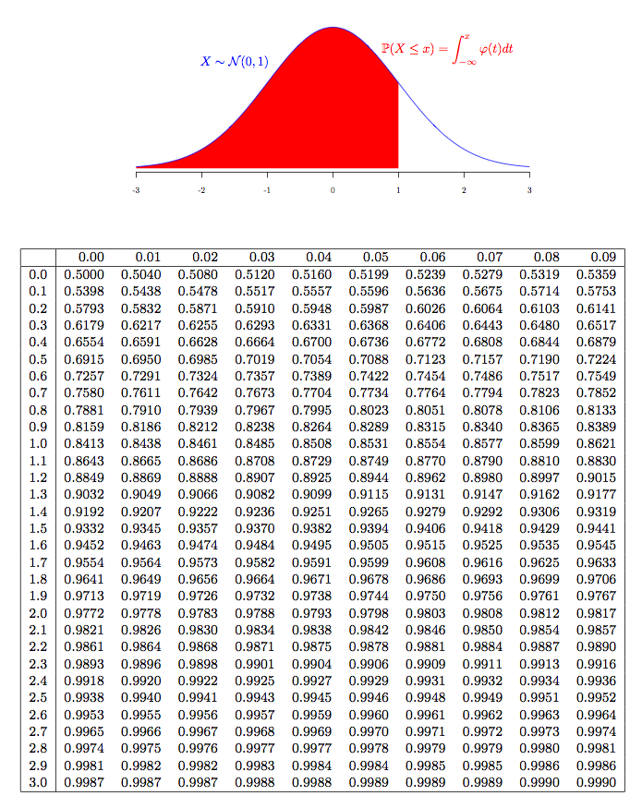

Slide 25
Thank you!

